Slide 1
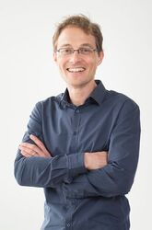
NIDDK P30 Center for Molecular Studies in Digestive and Liver Diseases
Research Seminar
12:00 PM – 1:00 PM
October 21, 2021
https://pennmedicine.zoom.us/j/92493022344?
pwd=b1NYU3VVaTFmUS9YdllDaEFGNmdSQT09
Pierre-Emmanuel Rautou, MD, PhD
Professor of Hepatology
Head of the Liver Hemodynamic Laboratory
Beaujon Hospital
Universite de Paris
“Role of endothelial cells in fatty liver diseases”
Meeting starts promptly at 12:00 pm. Please be on time.
Everyone inside and outside of the division is welcome to attend.
For more information, please visit our website. http://www.med.upenn.edu/gastro/

